Slide 1
Casualty Actuarial Society Automated Vehicle Task Force (CAS AVTF)
Wenwen Salerno, ACAS, MAAA
March 24, 2015

Slide 2
Vehicle operates as Windows System
Automobiles would frequently crash for no apparent reason. This would be so common that motorists would simply accept it, restart their car and continue driving.
Airbags would ask, 'Are you sure?' before deployment.
Vehicles would occasionally shut down completely and refuse to restart, requiring motorists to reinstall their engine.
www.vtpi.org/avip.pdf

Slide 3
Example of misuse
Infiniti video

Slide 4
CAS AVTF: Overview
Goal
The CAS AVTF is researching the technology’s risks to provide policymakers with the information needed to ensure the product is brought to market as safely and efficiently as possible.
Focus
Pre market
Post market
Post claim
identify & quantify risks
accurately price the technology
compensate claimants fairly & efficiently

Slide 5
Agenda
Automated Vehicles – Background
Automated Vehicle Risk Profile
Vehicle Symbol Analysis
Regulatory Overview

Slide 6
Agenda
Automated Vehicles – Background
Automated Vehicle Risk Profile
Vehicle Symbol Analysis
Regulatory Overview

Slide 7
Automated Vehicle Components
Automatic transmissions
Diverse sensors (cameras, radars, etc.)
Wireless network
Navigation system including GPS
Automated control (Steering, braking, signals, etc.)
Servers, software and power supply
www.vtpi.org/avip.pdf

Slide 8
Three key technologies for AVs
V2V/V2I
Vehicle to Vehicle or Vehicle to Infrastructure
Dedicated Short Range Communications (DSRC), similar to wifi
Vehicle to communication to other vehicles or infrastructure (traffic signals, toll booths, etc
LiDAR
Light Detection And Ranging
combination of light and radar, and uses laser light to create 3D images of the surrounding environment.
Remote sensing technology to measure distances
Inertial Navigation Systems & GPS
INS uses computers, accelerometers (motion), and gyroscopes (rotation)
Calculates position, orientation, and velocity
Notes:
http://driverlesscar.com/?p=71:
The word LIDAR is a combination of light and radar, and is properly pronounced Lī-där. It uses laser light to create 3d images of surrounding landscape in order to reference objects and obstacles around. It can be used on the ground to make highly accurate, 3D maps of any object. In conjunction with GPS, a driverless car can know not only exactly where it is, but where everything else is around it, including other cars, construction, etc. and whether those objects around it are stationary or at what speed and direction they are traveling.
http://www.autoinsuresavings.org/future-car-technology-vehicle-vehicle-v2v-communications/
V2I cars would be able to communicate with:
Traffic Lights
Road Signs
Built Infrastructure Systems for Vehicles
V2V has downsides
One of the drawbacks to V2V is the amount of time it would take for all vehicles to have communication benefits from V2V with some experts saying the technology wouldn’t be implemented completely until 2018 and others 2020. The answer? V2I. With V2I, it would allow all the safety benefits of V2V to be generated faster in most vehicles.

Slide 9
Cameras and Deep Learning may be another technology
NVIDIA @ CES 2015
NVIDIA video
Notes:
Deep learning
Today’s systems are usually unable to tell the difference between a trash can and traffic cop standing next to it, though
NVIDEA: Drive PX will help cars understand these issues
Interpret from 12 cameras at the same time
http://www.technologyreview.com/news/533936/ces-2015-nvidia-demos-a-car-computer-trained-with-deep-learning/
http://www.nvidia.com/object/drive-px.html
http://www.nvidia.com/object/drive-cx.html

Slide 10
Historic Developments
2005 – 2010
2012
2011
2013
2014
05: Stanford wins DARPA Grand Challenge
07: CMU wins DARPA Urban Challenge
09: Google begins testing on public roads
09: EU launches Project SARTRE
10: Volvo City Safe standard
Google surpasses 150K miles
BMW begins testing self driving car on public roads
NV passes autonomous car law
Google @ 300K accident free miles
Nissan opens research facility in Silicon Valley
Google & Continental receive autonomous car licenses
FL & CA pass autonomous car laws
Google @ 500K miles
Oxford creates a $7,750 self-driving system
Audi receives AV car license
NHTSA issues policy on AVs
DC passes AV car law
Public road testing
Britain
Mercedes
CMU
MI passes AV law
NHTSA passes V2V
Google @ 700k miles
Volvo ‘Drive Me’ tests in Gothenburg
Google developing driverless car without steering wheel or brakes

Slide 11
2015 has already had many new investments in AVs
Audi and Nvidia
January 2015
Audi will partner with Nvidea to use Tegra X1 chips to compute and process the data from sensors and cameras
Uber and Carnegie Mellon
February 2 2015
Strategic partnership including Uber Advanced Technologies Center
center will focus on the development of key long-term technologies
Apple
February 14 2015
Apple reportedly working on its own AV
Apple reportedly poaching Tesla and A123 engineers
Sony and ZMP
February 16 2015
ZMP, Japanese company makes ‘robot cars’
Sony’s image sensors and ZMP’s robotics to make AV
Notes:
http://driverlesscar.com/?p=71:
The word LIDAR is a combination of light and radar, and is properly pronounced Lī-där. It uses laser light to create 3d images of surrounding landscape in order to reference objects and obstacles around. It can be used on the ground to make highly accurate, 3D maps of any object. In conjunction with GPS, a driverless car can know not only exactly where it is, but where everything else is around it, including other cars, construction, etc. and whether those objects around it are stationary or at what speed and direction they are traveling.
http://www.autoinsuresavings.org/future-car-technology-vehicle-vehicle-v2v-communications/
V2I cars would be able to communicate with:
Traffic Lights
Road Signs
Built Infrastructure Systems for Vehicles
V2V has downsides
One of the drawbacks to V2V is the amount of time it would take for all vehicles to have communication benefits from V2V with some experts saying the technology wouldn’t be implemented completely until 2018 and others 2020. The answer? V2I. With V2I, it would allow all the safety benefits of V2V to be generated faster in most vehicles.

Slide 12
London’s AV testing regulations may increase investment
No special licenses or permits requires
No geographical limits
No additional insurance requirements
Goal
Light-touch non-regulatory approach
provides clarity for industry to invest in further in research
Notes:
2/11/2015

Slide 13
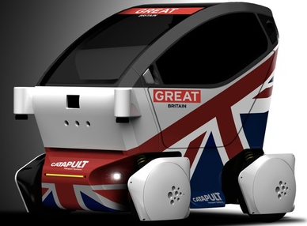
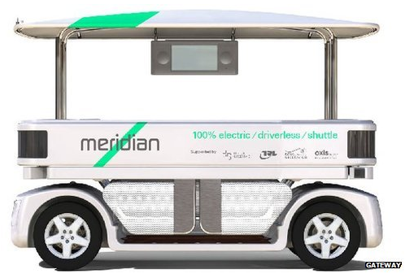
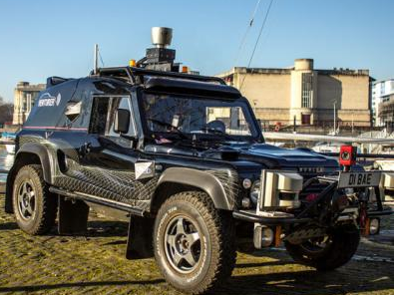
London has 3 trials underway
UK Autodrive Programme: 3 years to pave way for introduction of AVs
Dept. of Transportation put ~$29M USD for trials
Explore both legal and technical changes required for Autonomous Vehicles
Milton Keyes and Coventry
Greenwich
Bristol
Lutz Pods that drive in pedestrian zones
Max speed 15 mph
Electronic AV
GATEway shuttles
Electronic AV
Local tour with drop off points: input destination on CPU
Venturer consortium will investigate congestion and safety
BAE Wildcat
Notes:
http://www.coventrytelegraph.net/news/coventry-news/driverless-cars-trialled-coventry-roads-8625717

Slide 14
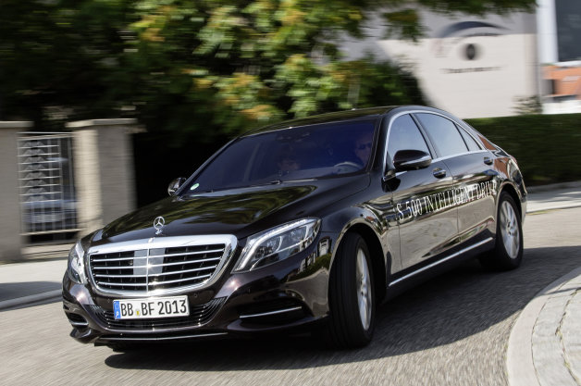
Future development may create two models for AVs
All driving, limited location
Some driving, all locations
End to end service
Only operates in specified area
“Taxi” service
Google, Uber
Takes over some of the driving
E.g. Supercruise, parallel parking
Only operates in specified area
Driver owns and operates
Mercedes, BMW, Volvo, Cadillac, Telsa
Notes:
Concept/layout stolen from Bryant Walker Smith’s talk at University of Minnesota

Slide 15
Agenda
Automated Vehicles – Background
Automated Vehicle Risk Profile
Vehicle Symbol Analysis
Regulatory Overview

Slide 16
“93% of accidents are caused by human error.”
Notes:
(1) The most thorough analysis of crash causation, the Tri-Level Study of the Causes of Traffic Accidents published in 1979, found that "human errors and deficiencies" were a definite or probable cause in 90-93% of the incidents examined. The executive summary is here (see vii), and the two-part final report is here and here. The study continues to be cited, and the Venn diagram on this page provides a useful summary.
(2) A UK study published in 1980 (summarized here at 88-89) likewise identifies driver error, pedestrian error, or impairment as the "main contributory factor[]" in 95% of the crashes examined.
(3) Another US study published in 2001 (available here) found that “a driver behavioral error caused or contributed to” 99% of the crashes investigated.
(4) An annual UK crash report (available here with updated data here in table RAS50002) identifies 78 potential contributing factors, most of which suggest human error. However, multiple factors were recorded for some crashes, and none were recorded for others.
(5) NHTSA’s 2008 National Motor Vehicle Crash Causation Survey is probably the primary source for the common assertion by NHTSA officials that “[h]uman error is the critical reason for 93% of crashes” (at least if “human error” and “driver error” are conflated). The 93% figure is absent from the report itself (probably intentionally) but calculable from the totals given on page 24.
NMVCCS
- Included 5,471 accidents from July 3, 2005 through December 31, 2007.
- Only includes accidents occurring between 6:00am and 11:59pm.
- The crash must have resulted in a harmful event associated with a vehicle in transport on a traffic way.
- EMS must have been dispatched to the crash scene.
- At least one of the first three crash-involved vehicles must be present at the crash scene when the NMVCCS researcher arrives.
- The police must be present at the scene of the crash when the NMVCCS researcher arrives.
- At least one of the first three vehicles involved in the crash must be a light passenger vehicle that was towed or will be towed due to damage.
- A completed police accident report for this crash must be available.

Slide 17
National Motor Vehicle Crash Causation Survey (NMVCCS) – Limiting Factors
Behavioral (Driver) Issues
Technology Issues
48.9%
32.4%
21.3%
16.7%
12.2%
11.6%
11.0%
0.4%
3.1%
2.3%
2.9%
Inclement Weather
Vehicle Issue
Inoperable TCD
Total
Technology
Issues
Driver Disables
Drugs
Physical Impairment
Driver Asleep
Total Behavioral Issues
Total
Distraction
Notes:
Human driver risk profile <> Automated vehicle risk profile
Separate benchmark must be calculated
Local benchmarks required
Inclement weather: Seattle vs. San Diego
Infrastructure deterioration
Driver usage remains an important piece of equation
Law abiding systems may be disabled more often
Technology’s appearance of safety may encourage risky behavior
Different tests required for the different risks
- Computer simulations can prove technology’s error rate, but provide little insight into driver’s actual use of technology.
Policy changes can increase AV’s safety.
Road magnets to overcome inclement weather
Driver training to reduce behavioral risk
Cost-benefit analysis
- Every 1% reduction in accidents corresponds to approx 55K fewer accidents, and $1.4 billion of economic value per yr

Slide 18
NMVCCS – Implications of the CAS Study
New benchmark should be calculated
Data is old and unrepresentative
Appropriate test for each risk
Computer simulations for technology’s error rate
Policy changes can increase AV’s safety
1% reduction in accidents is ~55k fewer accidents and $1.4 billion of economic value per year
Human driving risks <> automated vehicle risks
Policy cost benefit analysis
E.g. driver training program, automated vehicle only lanes, allowing the Avs to speed
Simulations provide little insight into driver’s actual use of technology.
Notes:
NMVCCS
- Included 5,471 accidents from July 3, 2005 through December 31, 2007.
- Only includes accidents occurring between 6:00am and 11:59pm.
- The crash must have resulted in a harmful event associated with a vehicle in transport on a traffic way.
- EMS must have been dispatched to the crash scene.
- At least one of the first three crash-involved vehicles must be present at the crash scene when the NMVCCS researcher arrives.
- The police must be present at the scene of the crash when the NMVCCS researcher arrives.
- At least one of the first three vehicles involved in the crash must be a light passenger vehicle that was towed or will be towed due to damage.
- A completed police accident report for this crash must be available.

Slide 19
Agenda
Automated Vehicles – Background
Automated Vehicle Risk Profile
Vehicle Symbol Analysis
Regulatory Overview

Slide 20
Vehicle symbol analysis approach
Vehicle experience groups
Each group’s experience is weighted and combined with similar vehicles
Complements to credibility
Vehicle’s body style factor
Prior year factor
Automated vehicle symbol: option 1
Assume a brand new vehicle
e.g. Mercedes introduces a new fully automated vehicle
No initial prior year factor, growth trend impacts credibility
Automated vehicle symbol: option 2
Assume update to a current vehicle
e.g. all new Honda Civics sold with AV equipment

Slide 21
Vehicle Symbol Calculation
Automated vehicle symbol: option 1
Assume a brand new vehicle
e.g. Mercedes introduces a new fully automated vehicle
No initial prior year factor, growth trend impacts credibility
Vehicle Symbol Discount
Number of Exposures |  | Loss Attenuation
 | Year | 0% | 25% | 50% | 75% | 100%
2,500 | 1 | 0.0% | 0.5% | 0.9% | 1.3% | 1.8%
5,000 | 2 | 0.0% | 1.4% | 2.6% | 3.9% | 5.1%
7,500 | 3 | 0.0% | 2.8% | 5.1% | 7.4% | 9.7%
10,000 | 4 | 0.0% | 4.4% | 8.0% | 11.6% | 15.2%
Notes:
Manufacturer tests have no bearing on rates. Only real world experience is considered.
It will take a long time for Vehicle Symbol calculation to recognize lower loss costs.
A new approach is likely warranted.
Insurers & regulators will need time and data to come up with a new and more accurate way to price the new vehicles.

Slide 22
Vehicle Symbol Calculation
Automated vehicle symbol: option 2
Assume update to a current vehicle
e.g. all new Honda Civics sold with AV equipment
Vehicle Symbol Discount
 | Loss Attenuation
Year | 0% | 25% | 50% | 75% | 100%
1 | 0.0% | 4.3% | 7.4% | 10.5% | 13.6%
2 | 0.0% | 7.1% | 13.7% | 20.0% | 26.3%
3 | 0.0% | 9.7% | 18.2% | 25.7% | 35.4%
4 | 0.0% | 11.1% | 21.0% | 31.0% | 41.2%
Notes:
Manufacturer tests have no bearing on rates. Only real world experience is considered.
It will take a long time for Vehicle Symbol calculation to recognize lower loss costs.
A new approach is likely warranted.
Insurers & regulators will need time and data to come up with a new and more accurate way to price the new vehicles.

Slide 23
Agenda
Automated Vehicles – Background
Automated Vehicle Risk Profile
Vehicle Symbol Analysis
Regulatory Overview

Slide 24
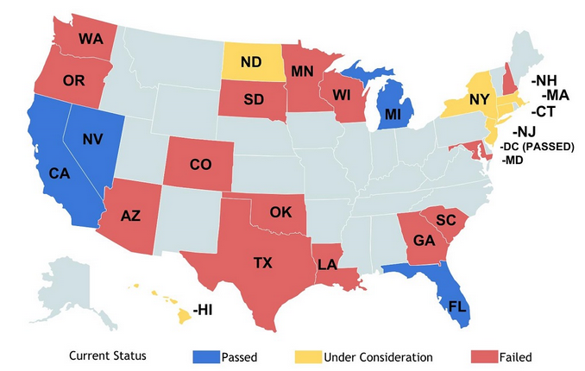
Current U.S. regulatory approach varies by state
Comments
CA, DC, FL, MI, NV have regulations that permit operation/testing of AVs
May 2013 NHTSA publication
Statement with guidance to states on AV regulations
Statement outlined NHTSA plans for testing AV technology
http://cyberlaw.stanford.edu/wiki/index.php/Automated_Driving:_Legislative_and_Regulatory_Action

Slide 25
Auto Manufacturer Regulations: Consumer Protection
NHTSA
establishes regulations that manufacturers must self-certify with
States
State regulators can impose additional requirements
Individuals
Individuals can sue manufacturers if an error occurs
Question?
What happens if automobile accident risk shifts entirely to manufacturers?
Notes:
What happens if automobile accident risk shifts entirely to manufacturers?

Slide 26
Regulatory approach needs to be updated
Insufficient protection for consumers and manufacturers
AlliedSignal, Inc v. Moran
NHTSA does not have the scale: annual budget
Auto Insurance
$M
NHTSA
IIHS-HLDI
NHTSA lacks financial incentive of auto insurance industry
Accurate evaluation of risk
Claims handling incentives
Compensating claimants fairly and efficiently is a core competence of the insurance industry
Auto industry’s competence is not insurance
Notes:
Explain these two cases – Conclude that just following NHTSA is not enough for protection for consumers or risk mitigation
NHTSA is small in comparison. If they are wrong, it makes no change to their bottom line. If insurers are wrong, financial consequences
The idea of an auto manufacturer insuring risk gives them a different incentive than auto insurer.
Auto insurer will want to pay efficiently – known as company that handles claims well
Auto manufacturer may want to fight claims to save face

Slide 27
Questions and Discussion

