Slide 1
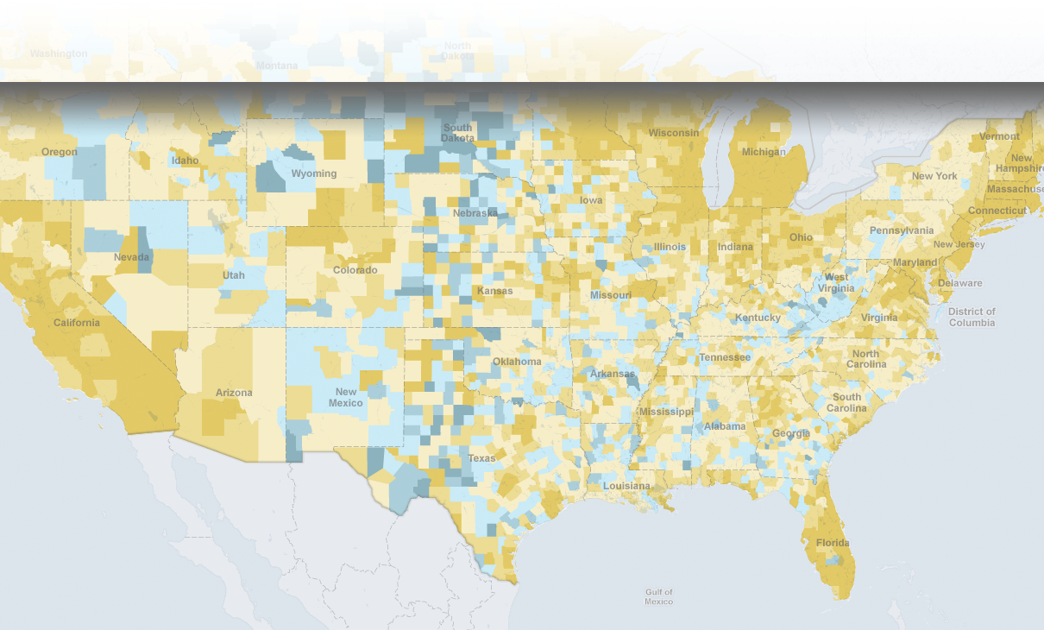
Geospatial Advances for Pricing
Commercial Fire, Theft & Vandalism
Location, Inc.

Slide 2
About Location, Inc.
Over a decade of Big Data Spatial Analytics from parcels to places
Led by a pioneering team of patented Ph.Ds. from Oak Ridge National Laboratory and the University of Washington
Focused on location-based tools to support high-risk, high-cost decisions
Industries Served:
Real Estate
Banking/Lending
Insurance
Retail
Location, Inc.

Slide 3
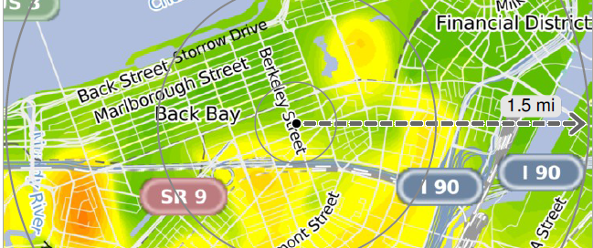
High Precision Predictive Crime Risk Analytics
Improved Risk Selection and Management Process
Deeply Granular Territory Segmentation
(over 3 billion geospatial points)
Reveal New Properties to Insure Down to the Address
Location, Inc.

Slide 4
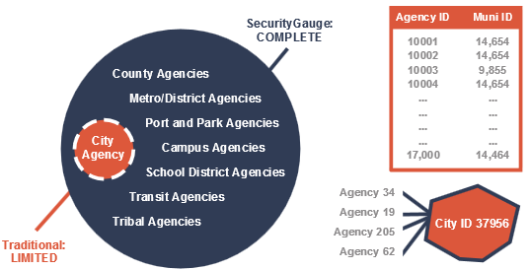
High Precision Predictive Crime Risk Analytics
Crime incident data from over 18,000 U.S. Agencies
Over 75 other data sources
Relational database to assign crime incidents to spatial jurisdictions.
Over 100 computer models
Location, Inc.

Slide 5
Crime Risk Index - Commercial Property
SecurityGauge® Property Crime Risk Index
10 | 82.4% Loss Ratio
9 | 44.4% Loss Ratio
8 | 26.8% Loss Ratio
7 | 26.3% Loss Ratio
6 | 26.1% Loss Ratio
5 | 21.2% Loss Ratio (National Average Risk)
4 | 19.8% Loss Ratio
3 | 16.5% Loss Ratio
2 | 16.2% Loss Ratio
1 | 6.9% Loss Ratio
49% OF THE BOOK
63% OF FIRE, THEFT & VANDALISM LOSSES
FOR A $147M BOOK:
77,700 POLICIES &
$74M IN PREMIUM
$22.7M IN LOSSES
Where are these losses coming from:
Fire, Theft, Vandalism, Agent Fraud, Other
(losses as a percent of premium)
Childcare, Bars/Restaurant,s Mercantile, Vacant Building &
Habitational (apartments and rental dwellings)
Location, Inc.
Notes:
Other sources of value of our data not shown here: Claims processing costs, take on new business with confidence in your pricing, possibly lower Green premiums to attract more low-risk policies into your book, also seeing some value for “All Other” (rotted tree falls, ice backs up in gutters – water damage, etc.).

Slide 6
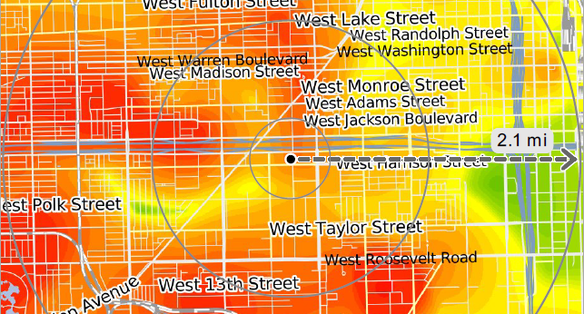
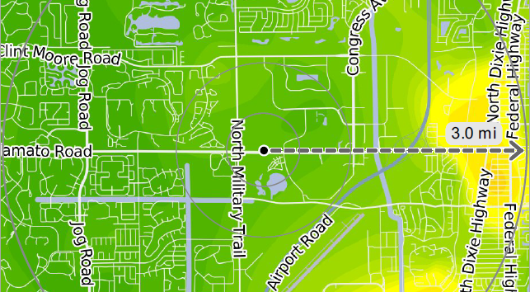
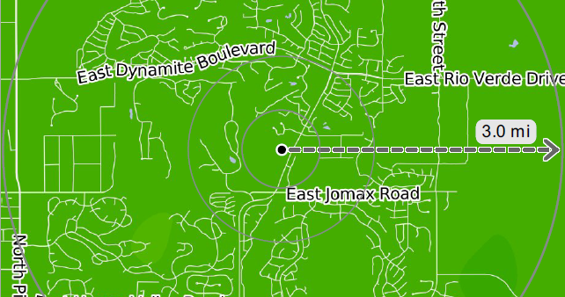
Risk Category Examples
Crime Risk Category 10
Crime Risk Category 5
Crime Risk Category 1
Location, Inc.
Location, Inc.
Location, Inc.

Slide 7
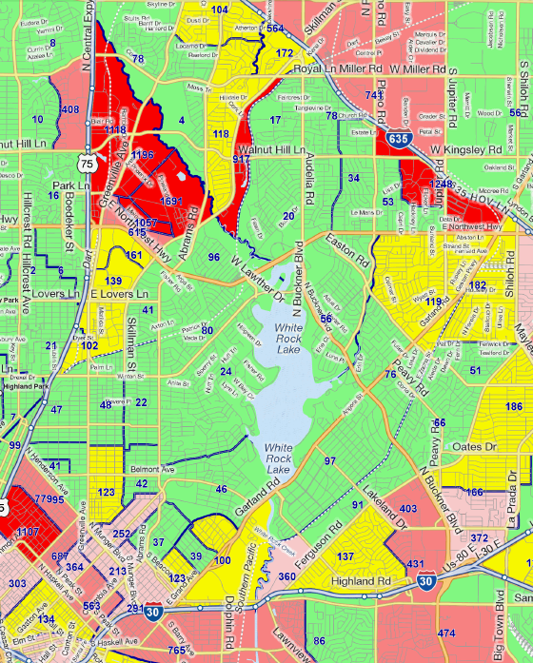
What’s New Here?
Current Industry Technology
SecurityGauge
Location, Inc.

Slide 8
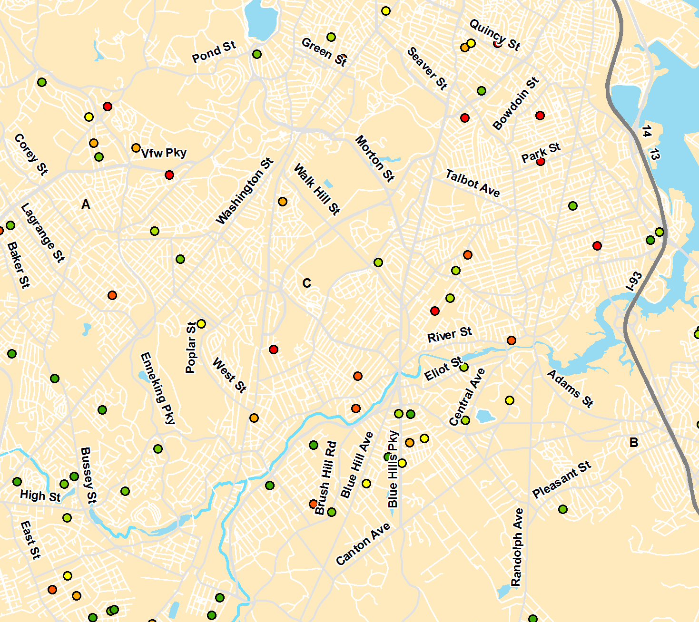
Fire & Crime - Current Pure Premiums
Pure Premium
Legend
Highest
Medium-High
Medium
Low-Medium
Lowest
Location, Inc.

Slide 9
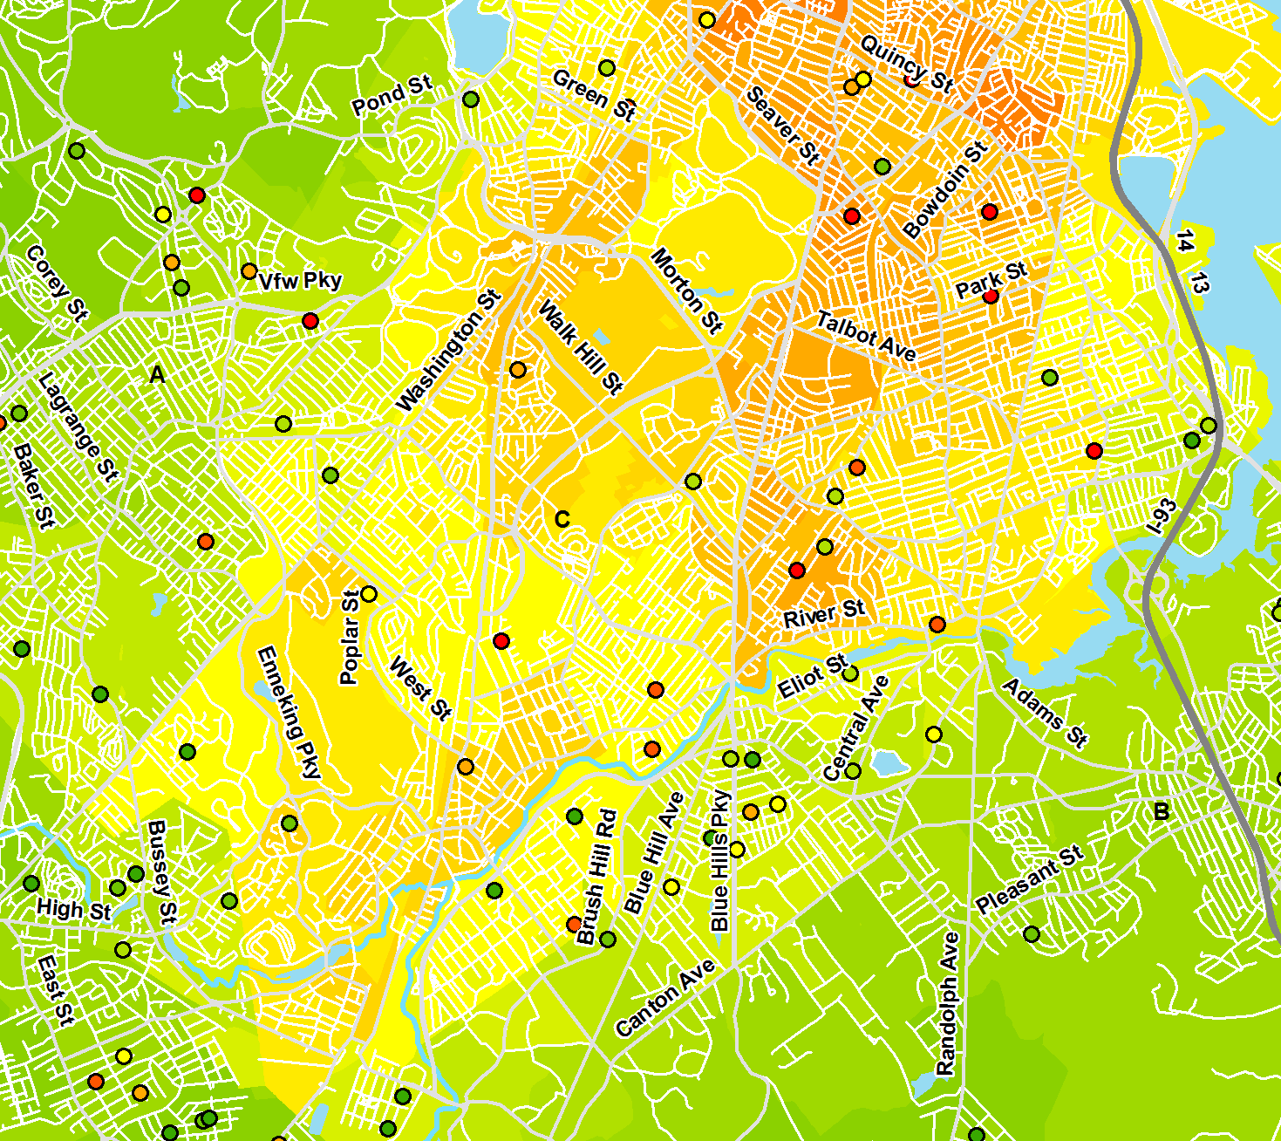
Location, Inc. Geospatial Layer Added (Adjusted Premiums)
Pure Premium
Legend
Highest
Medium-High
Medium
Low-Medium
Lowest
Location, Inc.

Slide 10
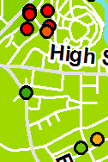
Pricing Model Lift
Carrier Using Over 20 Pricing Variables
CrimeRisk Added to Models
Underpriced Policies
Agents Binding
Adverse Selection
Overpriced Policies
Agents Not Binding
Competitive Risk
1 2 3 4 5 6 7 8 9 10
Location, Inc.

Slide 11
Loss Ratio Analysis
Location, Inc.

Slide 12
Crime Risk Index - Commercial Property
Average Loss Ratio
Location, Inc.
Location, Inc.
Confidential

Slide 13
Crime Risk Index - Commercial Property
Crime Risk Index | Average Crime Risk of Bin | Policy Years in Bin | % of Policy Years in Bin | Total Earned Premiums | TVF Claims Frequency (as % of Policy Years) | TVF Claims Severity per Policy Year | % of Total TVF Losses in Bin | TVF Loss Ratio
1 | 15 | 4,175 | 2.6% | $ 4,680,724 | 0.65% | $ 10.77 | 0.90% | 7%
2 | 30 | 16,059 | 10.1% | $ 16,330,955 | 0.72% | $ 4.21 | 7.38% | 16%
3 | 50 | 18,622 | 11.8% | $ 16,911,397 | 0.99% | $ 3.82 | 7.79% | 16%
4 | 71 | 21,287 | 13.5% | $ 18,617,566 | 1.03% | $ 3.12 | 10.32% | 20%
5 | 95 | 20,388 | 12.9% | $ 17,101,716 | 1.22% | $ 3.22 | 10.14% | 21%
6 | 122 | 15,221 | 9.6% | $ 13,440,440 | 1.39% | $ 6.75 | 9.89% | 26%
7 | 164 | 26,724 | 16.9% | $ 23,984,041 | 1.52% | $ 2.81 | 17.49% | 26%
8 | 260 | 25,631 | 16.2% | $ 25,748,908 | 2.13% | $ 2.45 | 19.26% | 27%
9 | 421 | 7,067 | 4.5% | $ 7,393,893 | 3.91% | $ 10.39 | 9.19% | 44%
10 | 614 | 3,064 | 1.9% | $ 3,319,798 | 4.57% | $ 33.69 | 7.64% | 82%
“TVF” stands for Theft+Vandalism+Fire
Location, Inc.
Location, Inc.
Confidential

Slide 14
New Book Growth Opportunity
Deep Segmentation
Block Level Shown
Unlocked
New Business Opportunity
Location, Inc.

Slide 15
www.SecurityGauge.com
Location, Inc.
86 Shrewsbury Street
Worcester, Massachusetts 01604
(508) 753-8029
sales@locationinc.com

